Slide 1
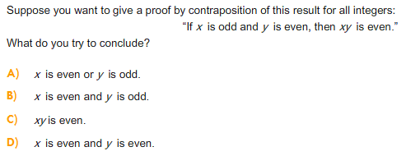
Proof
A)

Slide 2
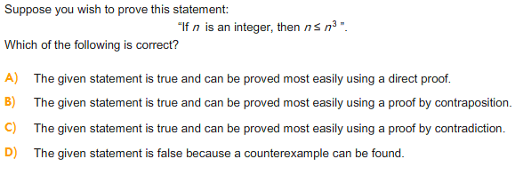
Proof
D)

Slide 3

Proof
C)

Slide 4
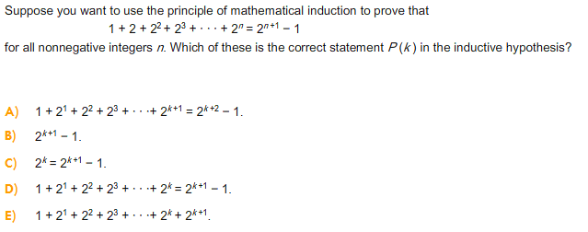
Mathematical Induction
D)

Slide 5

Mathematical Induction
B)

Slide 6

Mathematical Induction
C)

Slide 7



Counting

Slide 8


Counting

Slide 9

Counting
A)

Slide 10
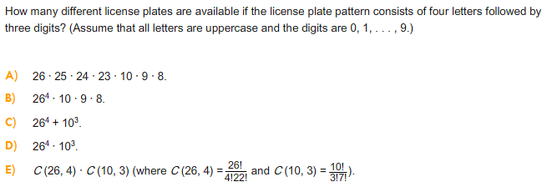
Counting
D)

Slide 11

Counting
D)

Slide 12

Counting
A)

